Slide 1

Gandhi Institute of Science and Technology Kholiguda ,Rayagada,Odisha Seminar : NanoTechnology
Kothakota Aaksshay Kumandan
Branch :CSE B.Tech Final Year
Regd No :1901317069

Slide 2


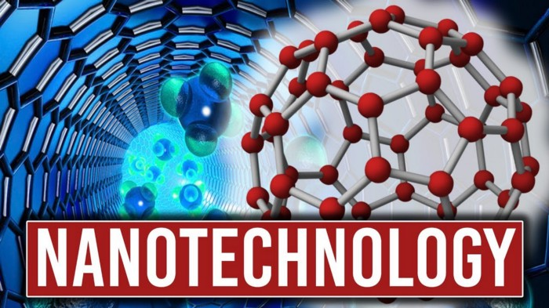




Slide 3
Agenda
Introduction To Nano Technology
Origins of Nano Technology
Definition of Nanotechnology
How Small Is Nanoscale?
Why is Nanotechnology?
What is Nano Material?
Nanomaterial's Characteristics
Various Products in Nanotechnology
Application of Nanotechnology
Future of Nanotechnology
Video about an Nanotechnology
Govt .policy
Advantages and Dis advantages of Nano Technology

Slide 4
Agenda
Implications of Nano Technology
Conclusion
References
Vote of Thanks

Slide 5

Introduction to Nano Technology
Nanotechnology has enormous potential to change society and it involves manipulation of objects on the atomic level.
The products will be build on every atom that are stronger ,smarter ,cheaper ,cleaner & more precise.
Nanotechnology is the art & science of manipulating matter at the nanoscale down to 1/100,000 the width of a human hair to create new & unique materials & products.

Slide 6

Origins of Nano Technology
Noble prize winner Richard Feynman first conceived the idea of molecular manufacturing in his 1959 speech, "There's Plenty of Room at the Bottom."
Richard Feynman was the first scientist to suggest that devices &materials could someday be fabricated to atomic specifications.
In 1986, K .Eric Drexler wrote "Engines of Creation" & introduced the term nanotechnology from there Scientific research really expanded over the last decade.

Slide 7
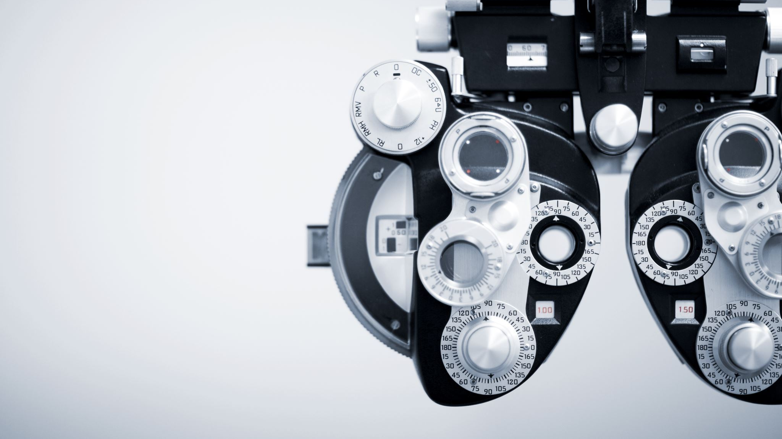
Definition of Nanotechnology
Nanotechnology is the understand & control of matter at dimensions of roughly 1 to 100 nanometers, where unique phenomena enable novel applications.
Encompassing nanoscale science ,engineering & technology ,nanotechnology involves imaging, measuring ,modeling & manipulating matter at this length scale.
.

Slide 8


How Small Is Nano Scale?
A nanometer is one billion of a meter.

Slide 9
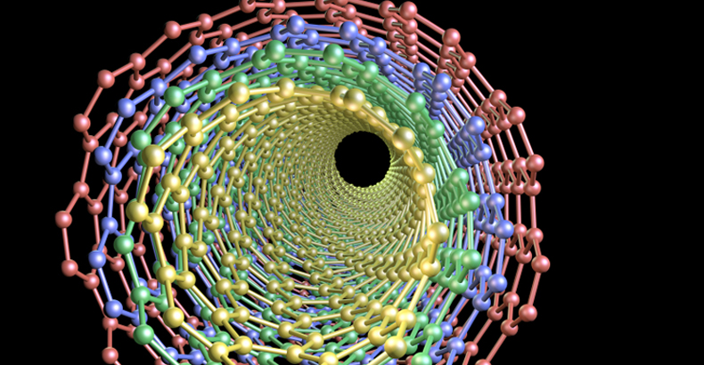
Why Nano Technology?
At the nanoscale, the physical ,chemical, & biological properties of materials differ in fundamentals & valuable ways from the properties of individual atoms & molecules or bulk matter.
Nanotechnology R & D I is directed forward understanding &creating improved materials ,devices , & systems that exploit these new properties.

Slide 10
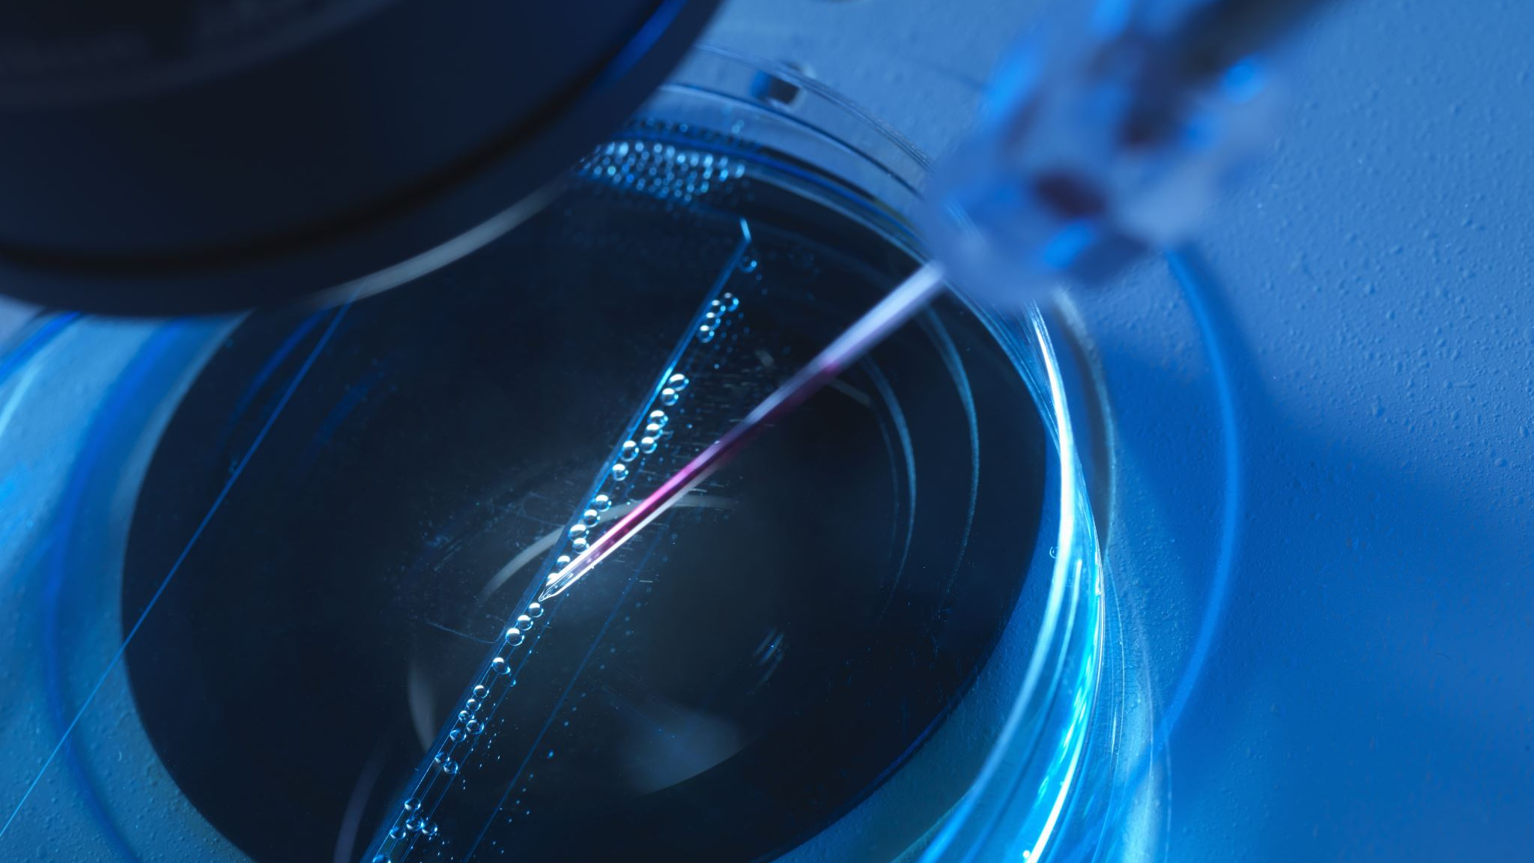
What is Nano material
Is defined as any material that has unique or novel properties , due to the nanoscale structuring.
These are formed by incorporation or structuring of nanoparticles.
They are subdivided into nanocrystals ,nano powders & nanotubes.
A sequence of nanoscale of C60 atoms arranged in a long thin cylindrical structure.

Slide 11
Nano Material Characteristics
Category Of Nanomaterials | Example
One –Dimensional Nanomaterials | Layers ,multilayers ,thin films platelets & surface coating. They have been developed & user for decades ,particularly in the electronics industry.
Two – Dimensional Nanomaterials Three –Dimensional Nanomaterials | Nanowires ,nano fibers made from a variety of element other than carbon, nanotubes & a subset of this group, carbon nanotubes. It is known as nanoparticles & include precipitates ,colloids & quantum dots & Nanocrystalline materials.

Slide 12
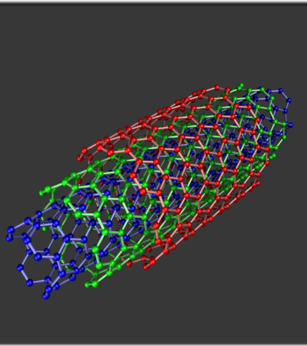
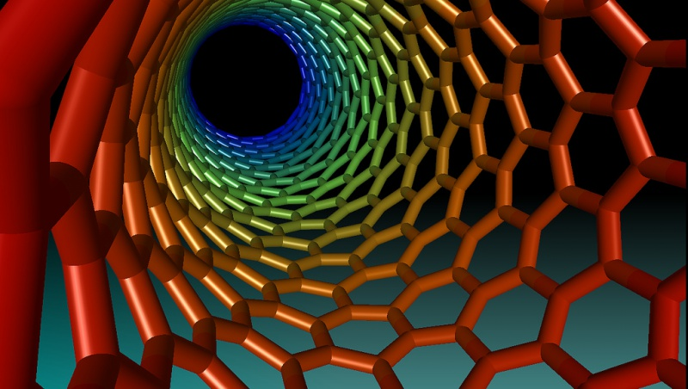


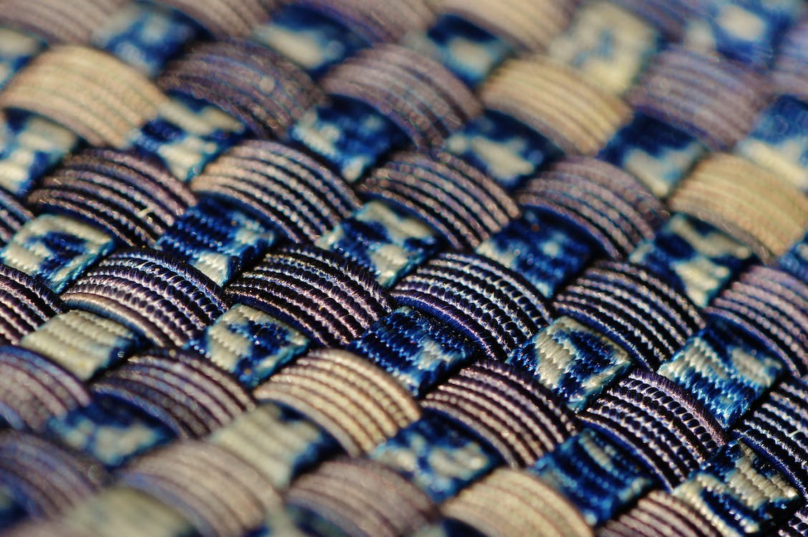

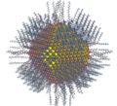


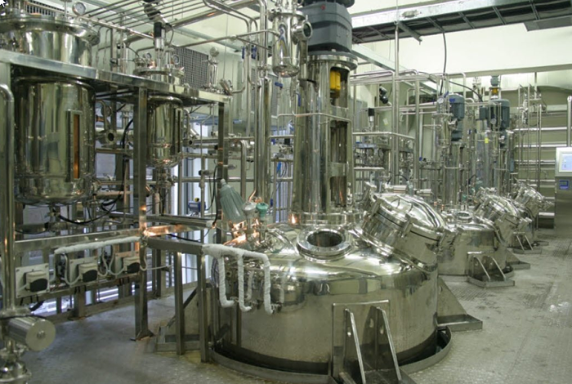




Various products in Nanotechnology
Building Products –45
Automotive –25
Marine Products – 2
Textile & fabric –17
Medical & health –31
Nano particle - 65
Electronics & computers – 16
Industrial Products –75
Cosmetics –27
Food – 16
Home & Garden –37
R & D –7

Slide 13
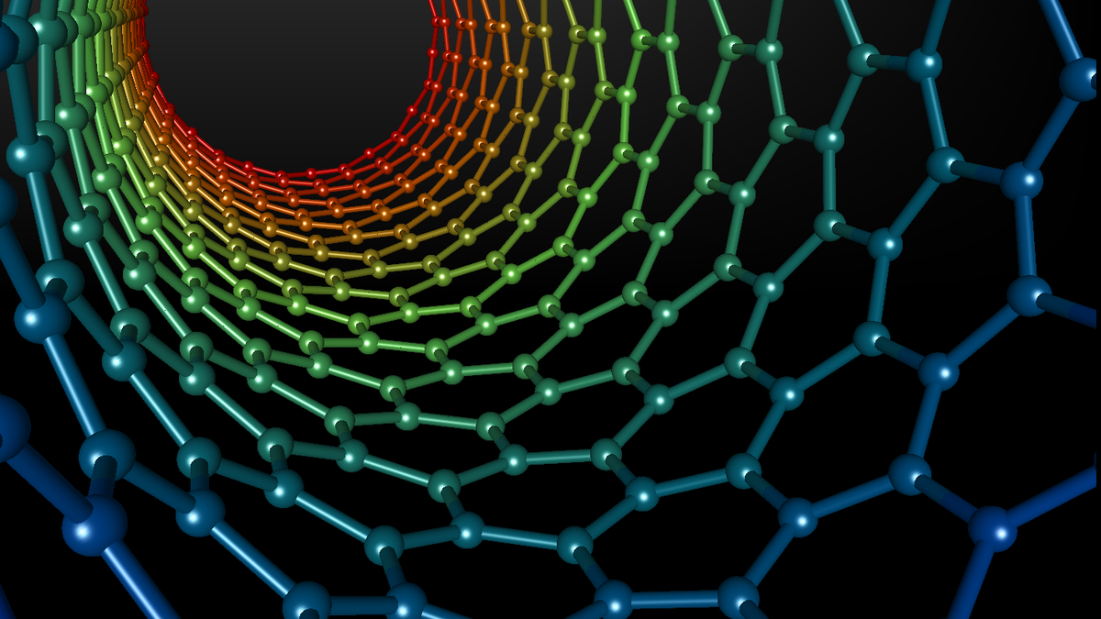
Applications Of Nanotechnology
Electronics
Nano Transistors
Nano Diodes
OLED (Organic Light Emitting Diode)
Plasma Displays
Quantum Computers

Slide 14
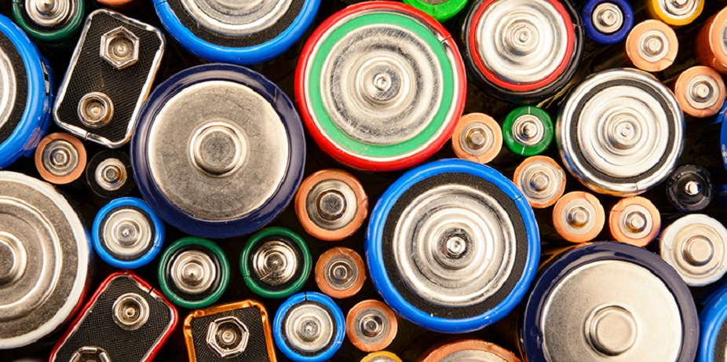
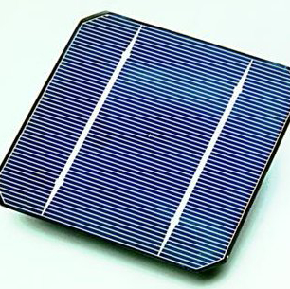
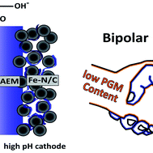
Energy
Batteries
Fuel Cells
Solar Cells

Slide 15
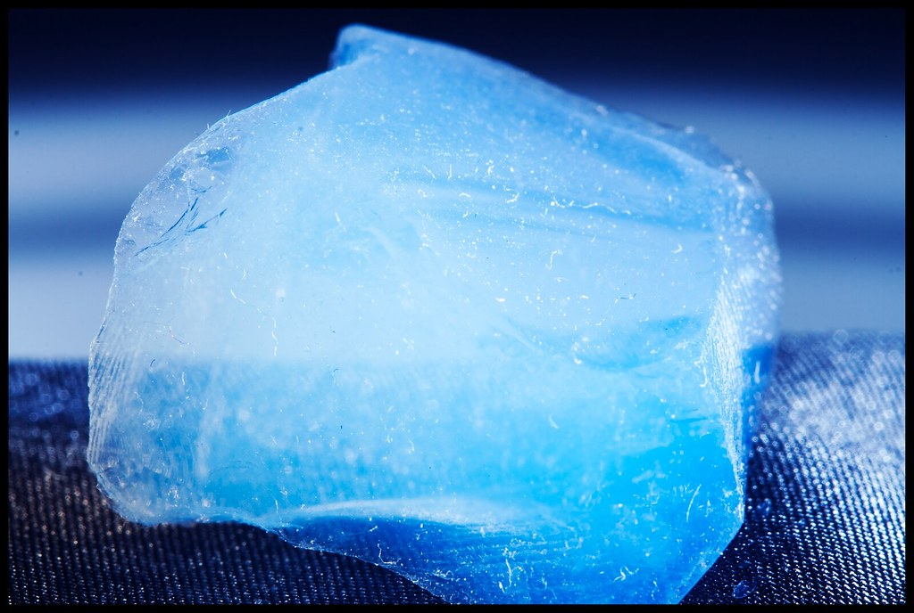
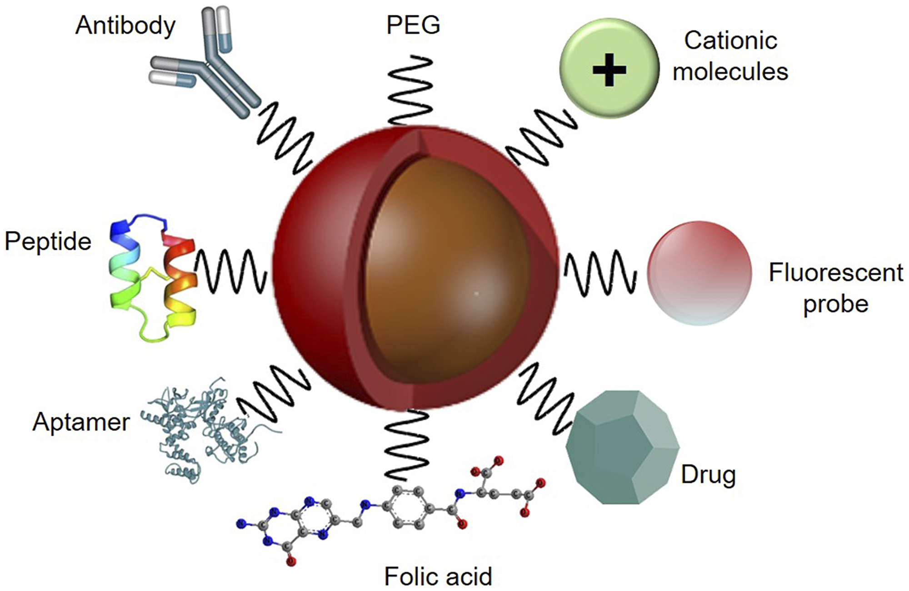
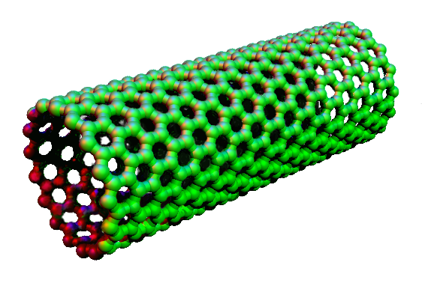
Materials
Nano Tubes
Aerogel
Nano Particle

Slide 16

Future Of Nano Technology
Nano technology will redesign the future of serval technologies ,products & markets.
Scientists & engineers can now work with materials at atomic level to create stain - proof fabrics, scratch - resistant paints ,more efficient fuel cells & batteries.
Experts says that nano technology will likely create the next generation of billionaires & reshape global business.
Industry Analysts Predict Revenues from Products Incorporating Nano Technology to reach close to $3 Trillion US Within 10 Years.

Slide 17
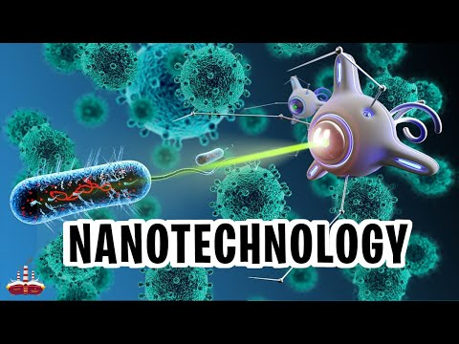

Slide 18
Govt .Policy
The Government of India has made Rs .1000 core investments in Nanotechnology.
Karnataka is planning to set up country's first nano park in Bangalore .
Govt of Andhra Pradesh is planning to set up Nano - Technology Park in 350 acre in Hyderabad.

Slide 19
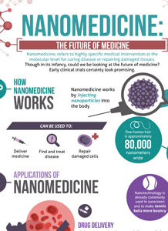
Advantages Of Nano Technology
Medical Advantages
End of illness like (Cancer ,heart disease)
Universal immunity like (aids, flu)
Body Sculpting (change your appearance)
Stop the aging process
Painless Child Births

Slide 20
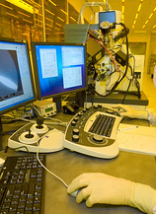
Industrial Advantages
Computers a billion times faster & a million times smaller.
Automatic Pollution Cleanup.
Manufacturing at almost no cost.

Slide 21
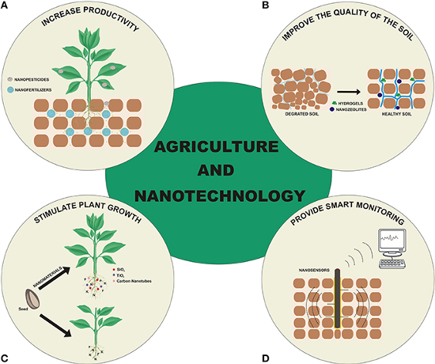
Disadvantages Of Nanotechnology
Loss of jobs (manufacturing ,farming )
Oil Becomes worthless
Diamonds become worthless
Atomic weapons more accessible & destructive
T

Slide 22
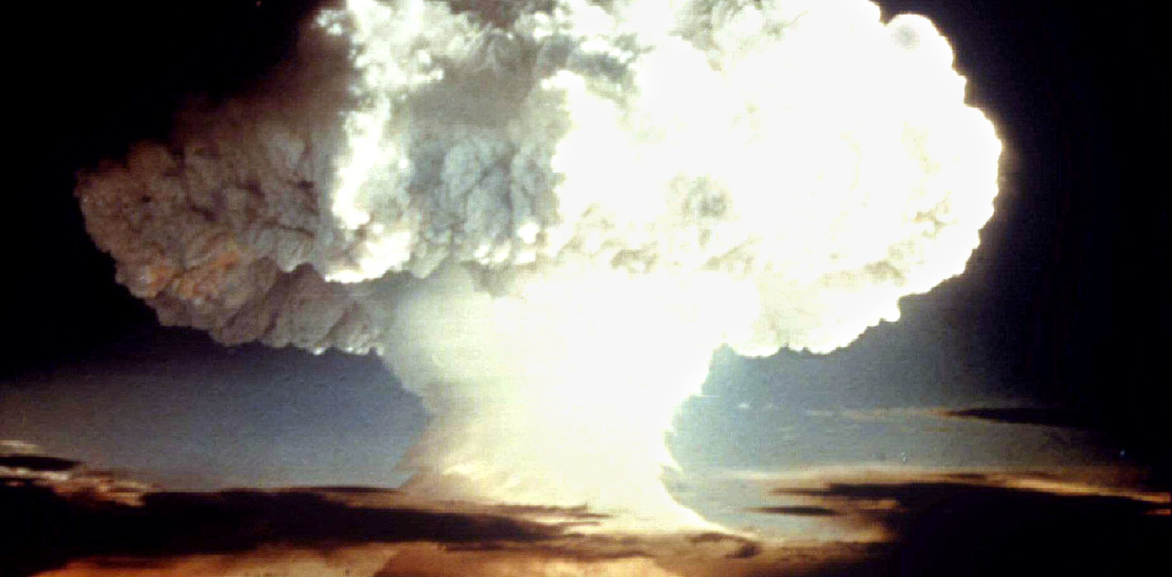
Implications In Nano Technology
Health & Safety Issues
Nano particles can cause serious illness or damage human body.
Untraceable destructive weapons of mass destruction.

Slide 23
Social & Political Issues
Create social strife through increasing wealth gap.
Advisability of increasing scope of the technology creates
political dilemma.

Slide 24

Conclusion
Nanotechnology offers the ability to build large number of products that are incredibly powerful.
Nanotechnology is heavily intertwined with biotechnology & information technology ,making its scope very wide.
The nanotechnology industry is mainly used to create new world.

Slide 25

References
Morph :Nokia's Nanotechnology Concept by phone http://tini.us/morph.
Wikipedia NT Portal
http://wikipedia.com

Slide 26


